Slide 1
8259A Priority Interrupt Controller (PIC)

Slide 2
8259A Block diagram
8259A system connections and Cascading
Initializing an 8259A
Initialize command word
Operational Command word
Modes

Slide 3
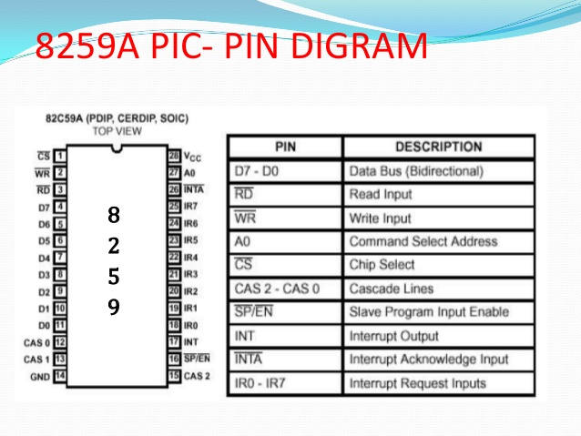

Slide 4
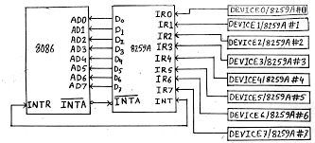
Basic connection between PIC 8259 & 8086

Slide 5
8259A system connections and Cascading
A0 to select one of two internal address
A0 is connected to A1 of system
System addresses of two pins are FF00H and FF02H
8 bit data bus of 8259A is connected to lower 8 bit data bus of 8086
Connect RD and WR of 8259 to 8086
INTA of 8259A is connected to INTA of 8086
INT pin of 8259A is connected to INTR of 8086

Slide 6
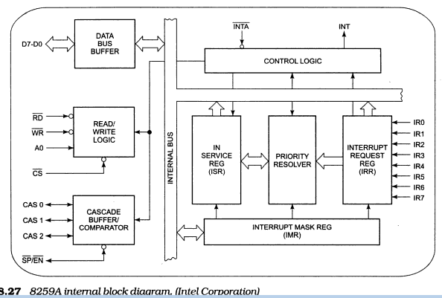
8259A Block diagram

Slide 7
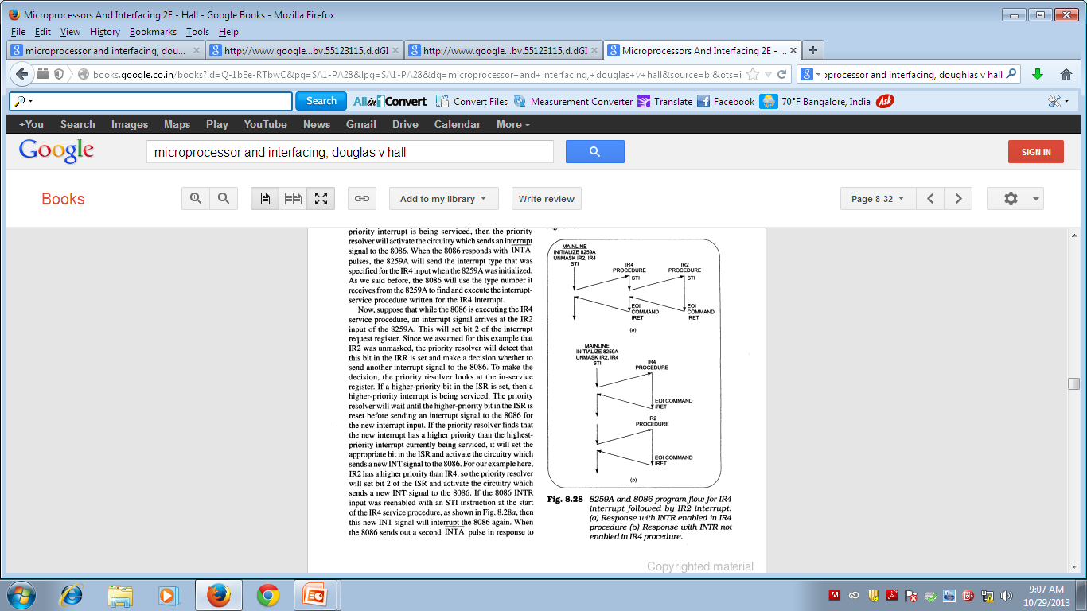

Slide 8
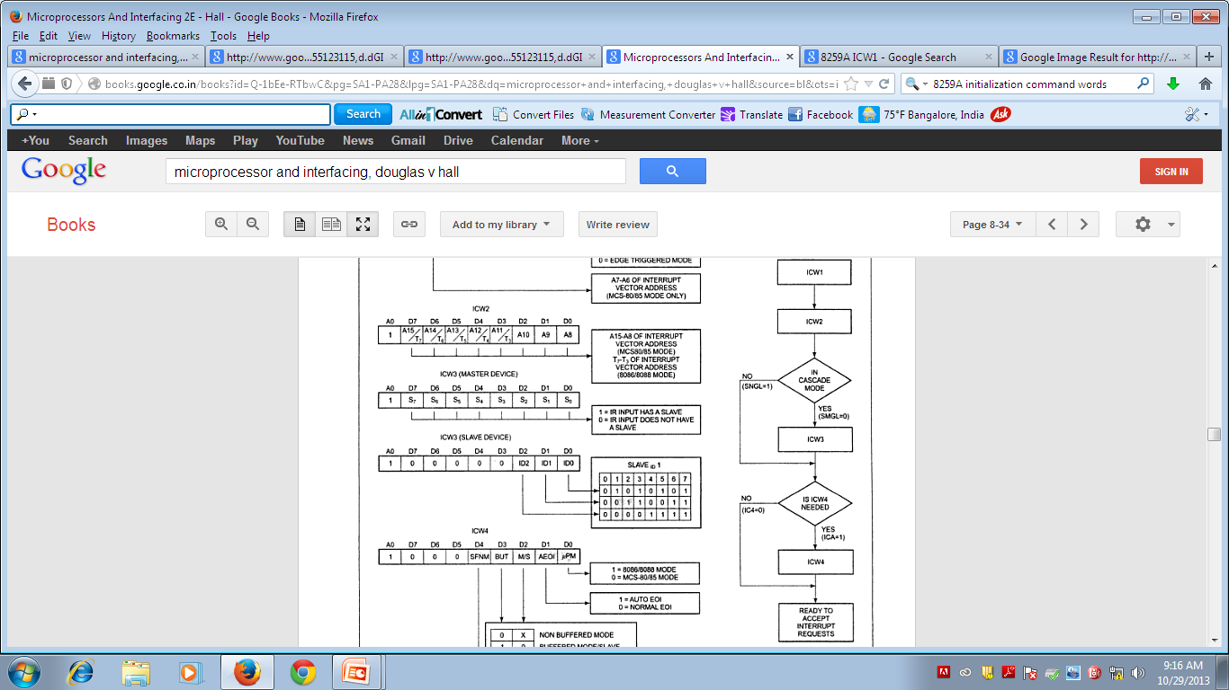
Initializing an 8259A

Slide 9
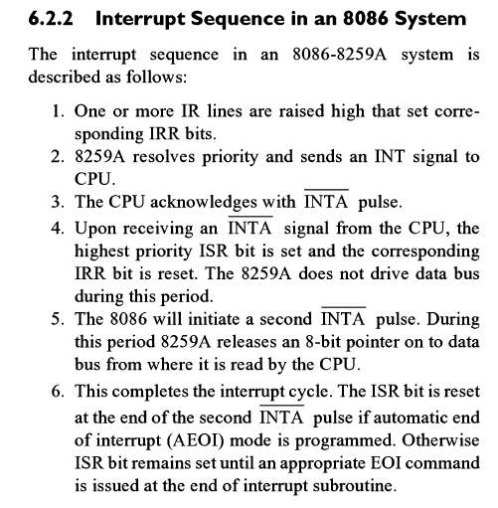

Slide 10
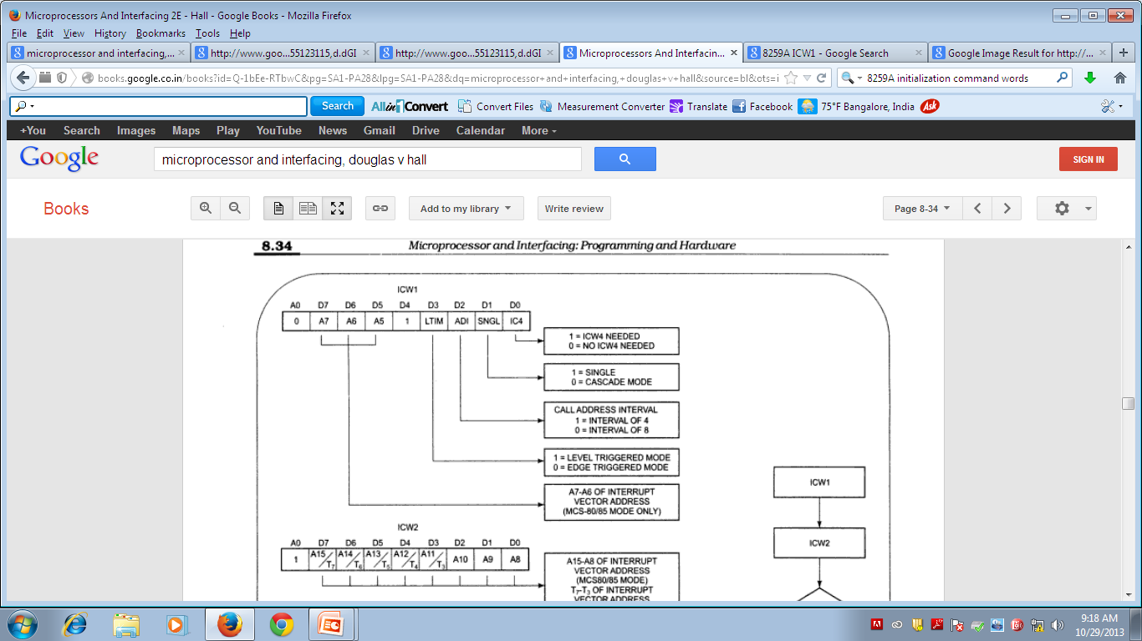
ICW 1 and ICW 2

Slide 11
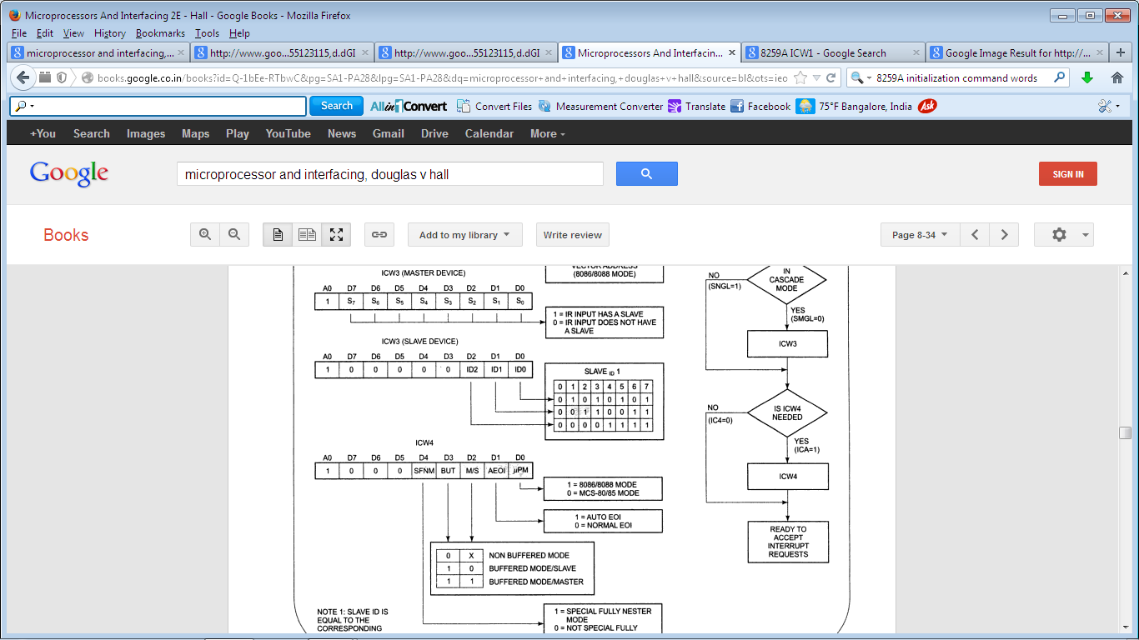
ICW 3 and ICW 4

Slide 12
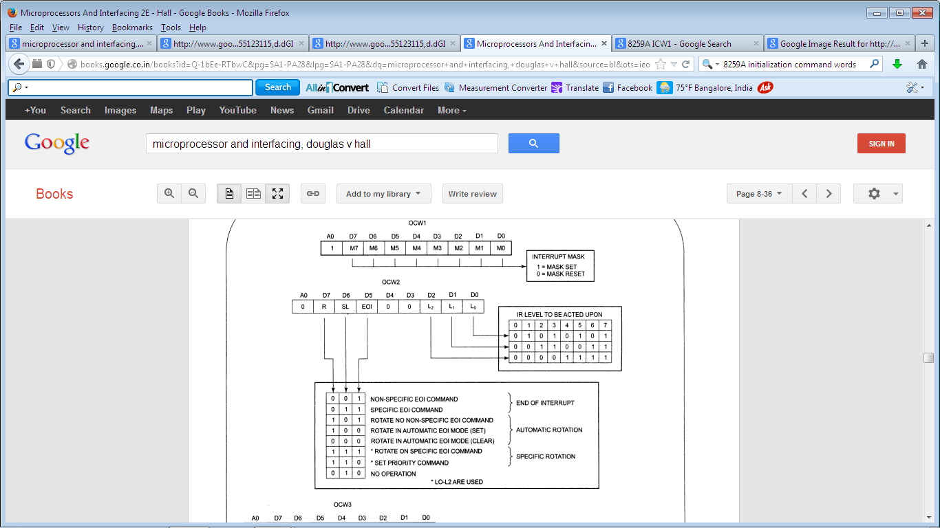
Operational command word-OCW 1 and OCW 2

Slide 14
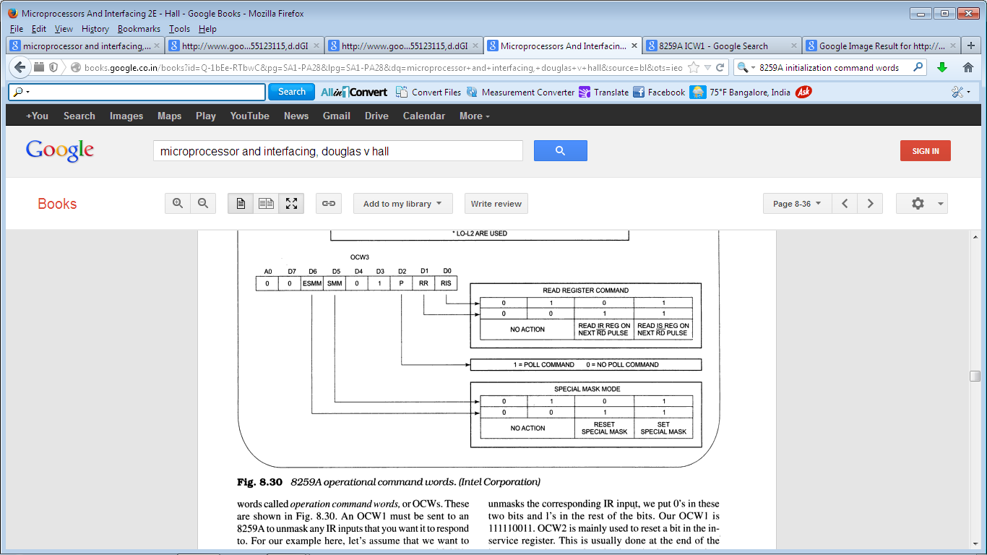
OCW-3

Slide 16
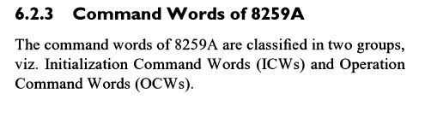
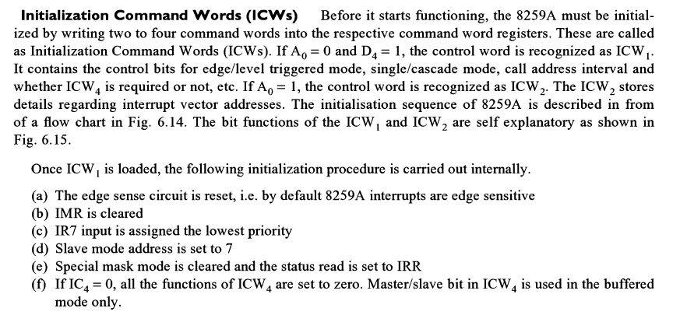

Slide 17
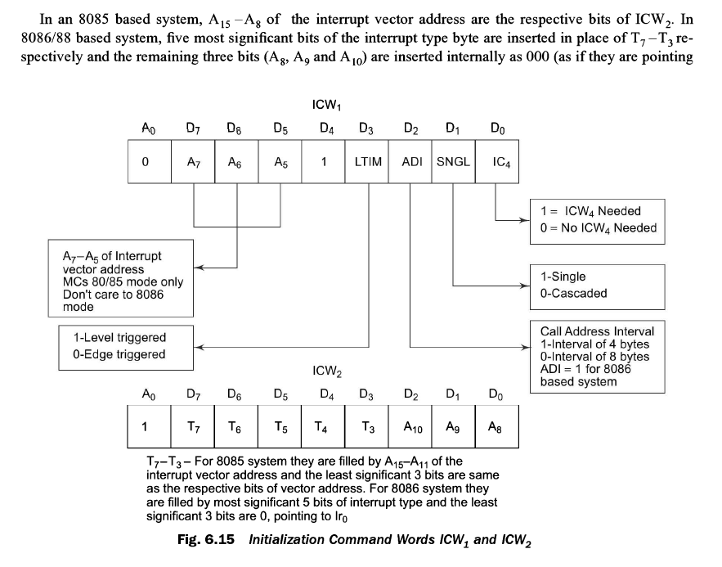

Slide 18
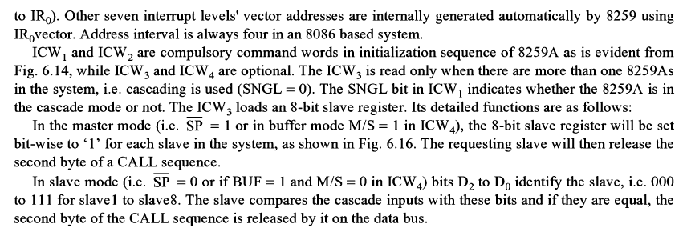

Slide 19
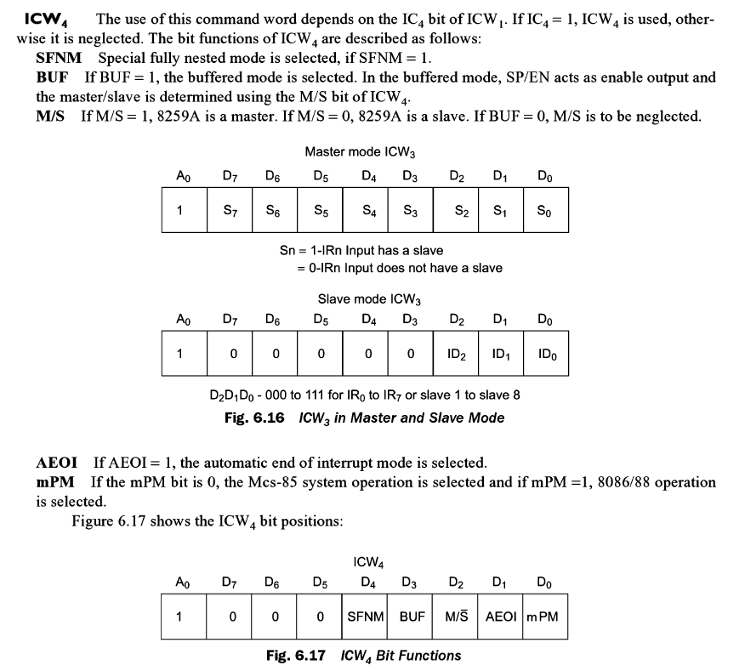

Slide 20
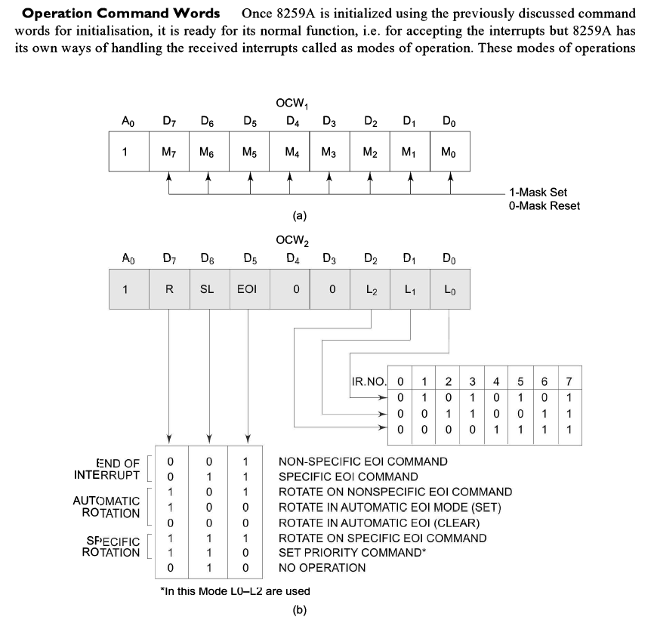

Slide 21
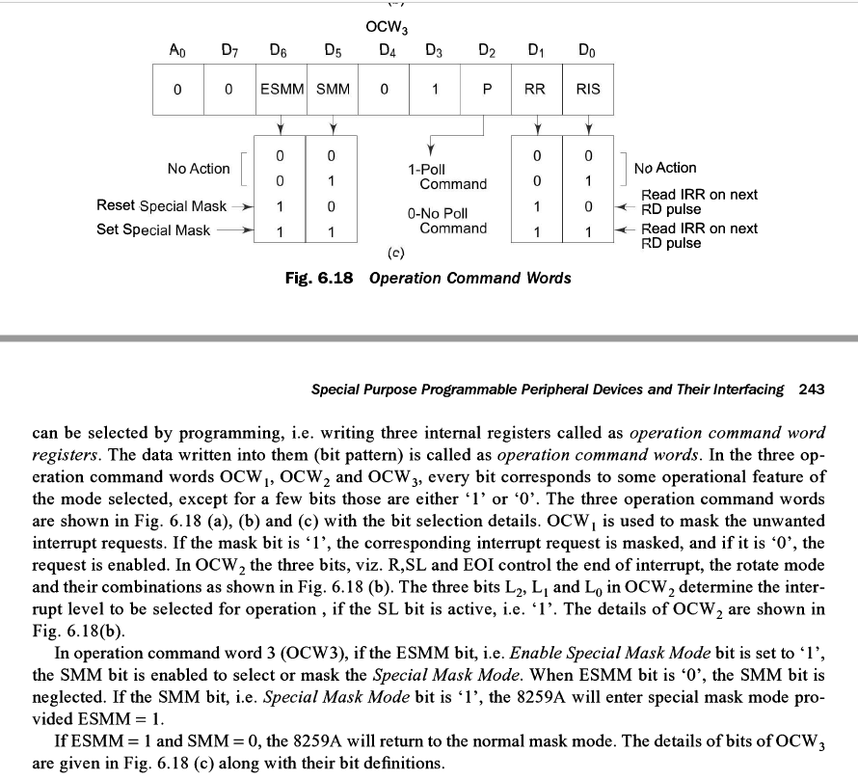

Slide 22


Slide 23
Modes of 8259A
Fully Nested mode
Special Fully Nested mode
Nonspecific Rotating
Specific Rotating
Special Mask
Polling
Fixed priority mode

Slide 24
Modes of 8259A
Fully nested mode:
This is a general purpose mode where all IR’s are arranged in highest to lowest. IR0 highest and IR7 lowest.
Special Fully Nested Mode
Used in more complicated systems.
Similar to, normal nested mode.
When an interrupt request from a certain slave is in service, this slave can further send requests to the master.
The master interrupts the CPU only.
AUTOMATIC ROTATION MODE
In this mode a device after being serviced receives the lowest priority.
SPECIFIC ROTATION MODE
In this user can select any IR for lowest priority thus fixing all priorities.

Slide 25
Special Mask Mode
When a mask bit is set in OCW, it inhibits further interrupts at that level and enables interrupt from other levels, which are not masked.
Poll command
The INT output is neglected, though it functions normally by not connecting INT output or by masking INT input of the microprocessor.
This mode is entered by setting p=1 in OCW3.
A poll command may give more than 64 priority levels.

Slide 26
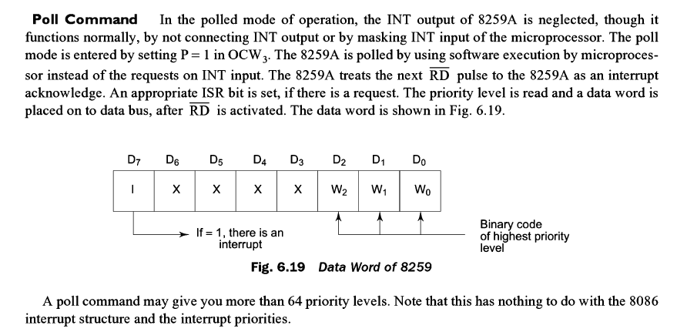

Slide 27
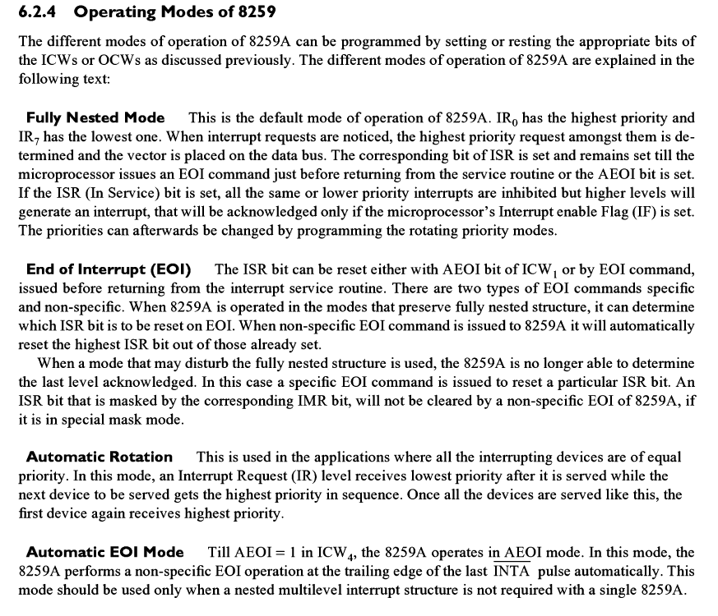

Slide 28
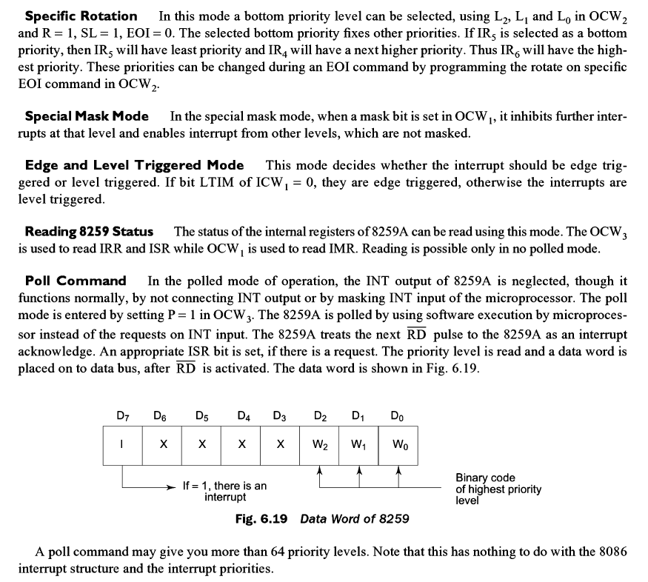

Slide 29
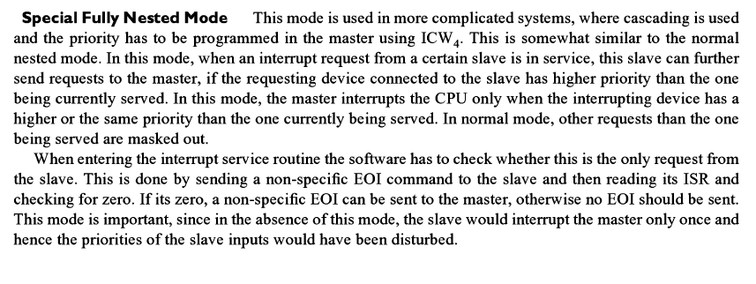
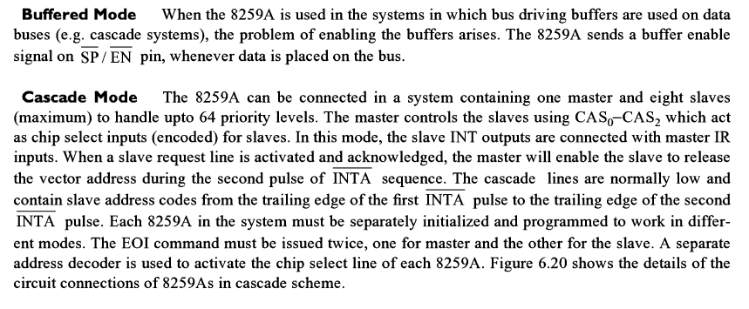

Slide 30
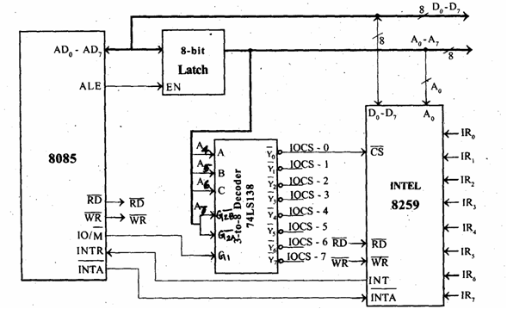
Interfacing of 8086-8259
8259 in single mode

Slide 31
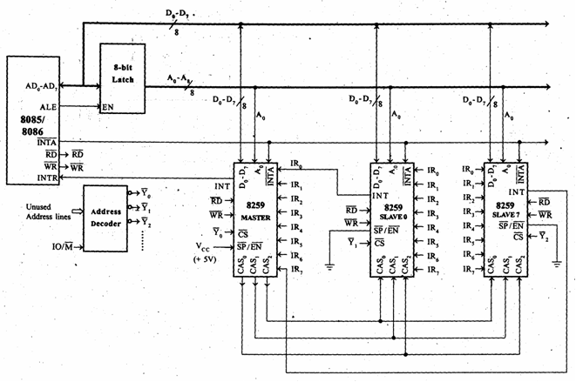
In cascading mode

Slide 32
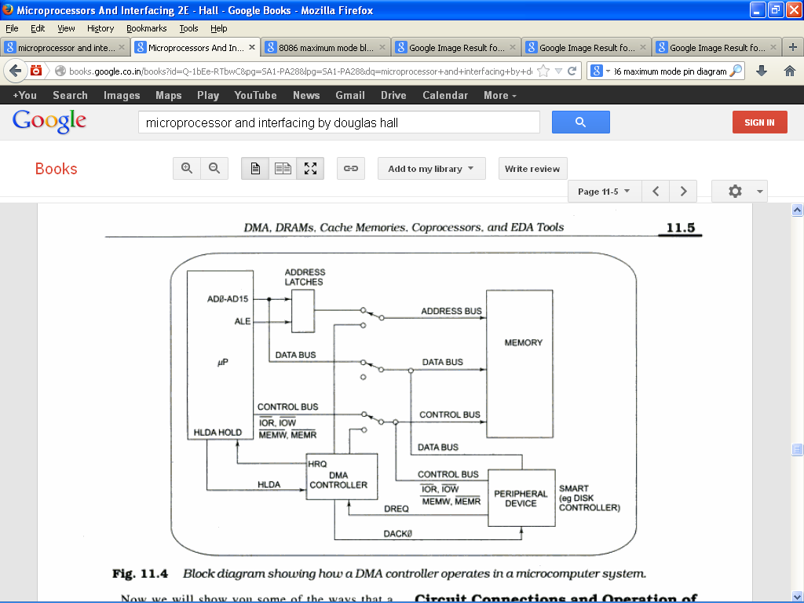
Operation of DMA in microcomputer

Slide 33
Direct Memory Access
Direct memory access (DMA) is a process in which an external
device takes over the control of system bus from the CPU.
DMA is for high-speed data transfer from/to mass storage peripherals,
e.g. hard-disk drive, magnetic tape, CD-ROM, and sometimes video controllers.
For example, a hard disk may boasts a transfer rate of 5 M bytes per
second, i.e. 1 byte transmission every 200 ns.
To make such data transfer via the CPU is both undesirable and unnecessary.
The basic idea of DMA is to transfer blocks of data directly between
memory and peripherals. The data don’t go through the microprocessor but
the data bus is occupied.
The DMA transfer requires only 5 clock cycles.

Slide 34
Basic process of DMA
For 8086 in maximum mode:
The RQ/GT1 and RQ/GT0 pins are used to issue DMA request and receive
acknowledge signals.
Sequence of events of a typical DMA process
1) Peripheral asserts one of the request pins, e.g. RQ/GT1 or RQ/GT0 (RQ/GT0 has higher priority)
2) 8088 completes its current bus cycle and enters into a HOLD state
3) 8088 grants the right of bus control by asserting a grant signal via the same pin as the request signal.
4) DMA operation starts
5) Upon completion of the DMA operation, the peripheral asserts the request/grant pin again to relinquish bus control.
For 8086 in minimum mode:
The HOLD and HLDA pins are used instead to receive and acknowledge the
hold request respectively.
Normally the CPU has full control of the system bus. In a DMA operation, the
peripheral takes over bus control temporarily.

Slide 35
DMA controller
A DMA controller interfaces with several peripherals that may request DMA.
The controller decides the priority of simultaneous DMA requests
communicates with the peripheral and the CPU, and provides memory
addresses for data transfer.
DMA controller commonly used with 8088 is the 8237 programmable device.
The 8237 is in fact a special-purpose microprocessor.
Normally it appears as part of the system controller chip-sets.
The 8237 is a 4-channel device. Each channel is dedicated to a specific
peripheral device and capable of addressing 64 K bytes section of memory.

Slide 36
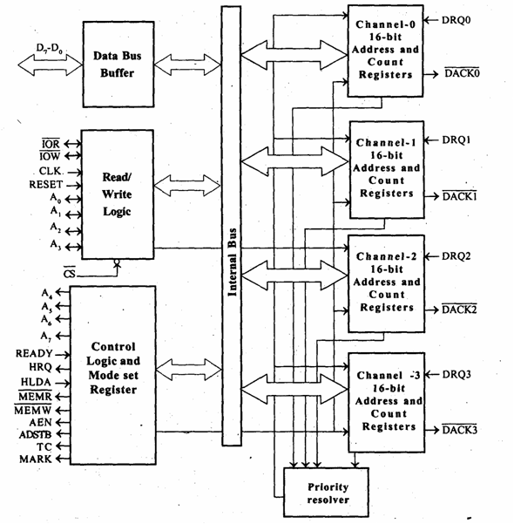
DMA controller - 8257

Slide 37
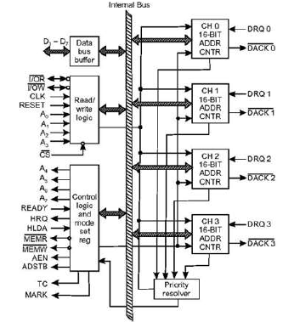

Slide 38
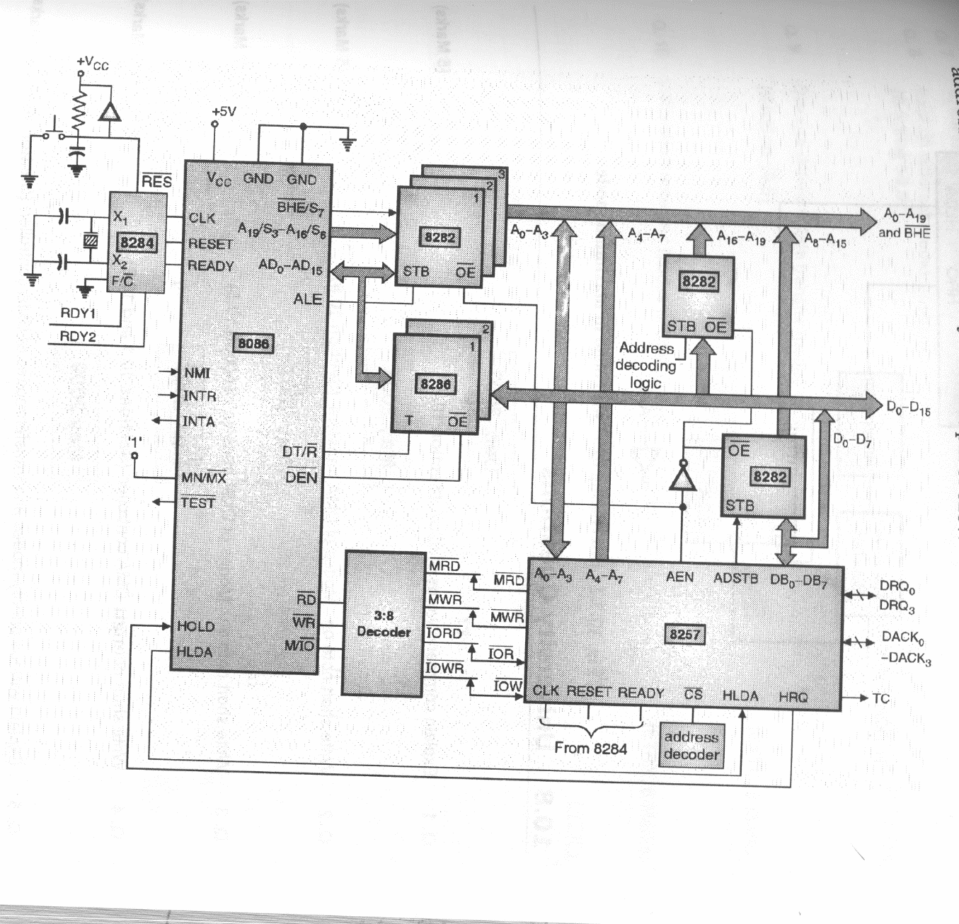
8086-8257

